Slide 1
The bigger picture
RTLS in Hospital Operations

Slide 2
“If you cannot measure it,
you cannot improve it.”
Lord Kalvin
1824 - 1907
Simply Manage
2

Slide 3
Challenges in Hospital Operations
Hospitals are very complex to manage
Informed decisions are critical – totally depend on data
80% of operational data is invisible to managers (and ERP) *
  Huge effect on patient care, care cost & outcome
  US Healthcare is wasting ~$1T / year *
* JAMA 2019 Waste in the US Health Care System: Estimated Costs and Potential for Savings
Simply Manage.
3

Slide 4
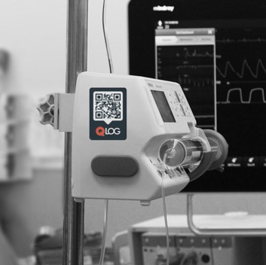

The need for real-time data
Infrastructure
Assets & equipment
Task prioritizing
Staff Productivity
Patient Flow Optimization
Simply Manage.
4

Slide 5
Digital Twin
Simply Manage
5

Slide 6

Real Time
Locating Systems
ASSET & FACILITY MANAGEMENT
1998 1st commercial use
2000 $1M
2010 $100M 150$ tags
2020 $1B 2-10$ tags
2030 $10B
WORKFLOW OPTIMIZATION
QUALITY & COMPLIANCE
Simply Manage.
6

Slide 7




How RTLS Work
Location aware / Location agnostic
Passive
Passive RFID
Cameras
Radar
Active
IR
Radio frequency
Simply Manage.
7

Slide 8
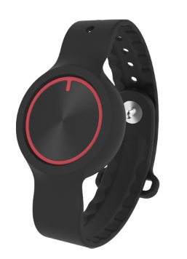
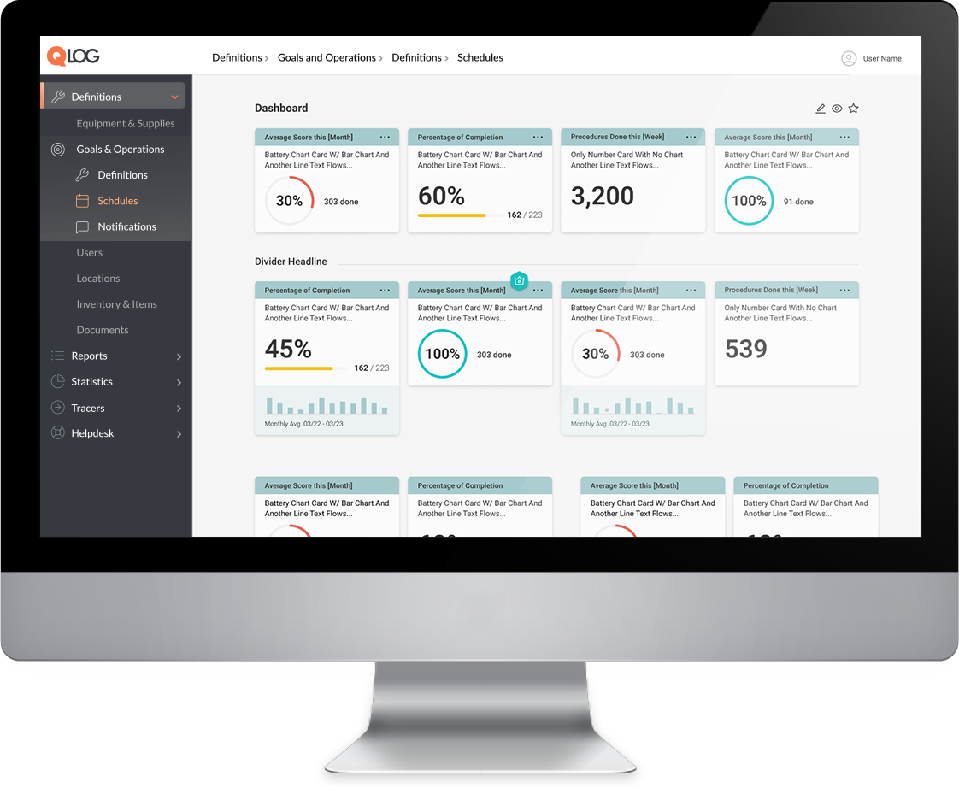
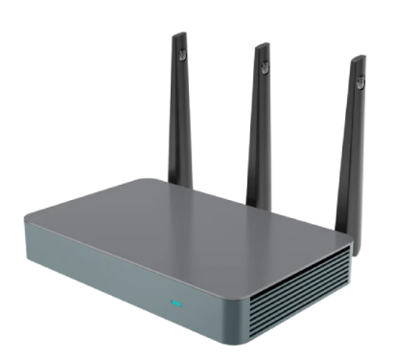


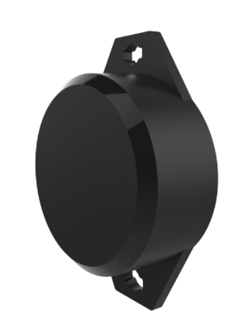
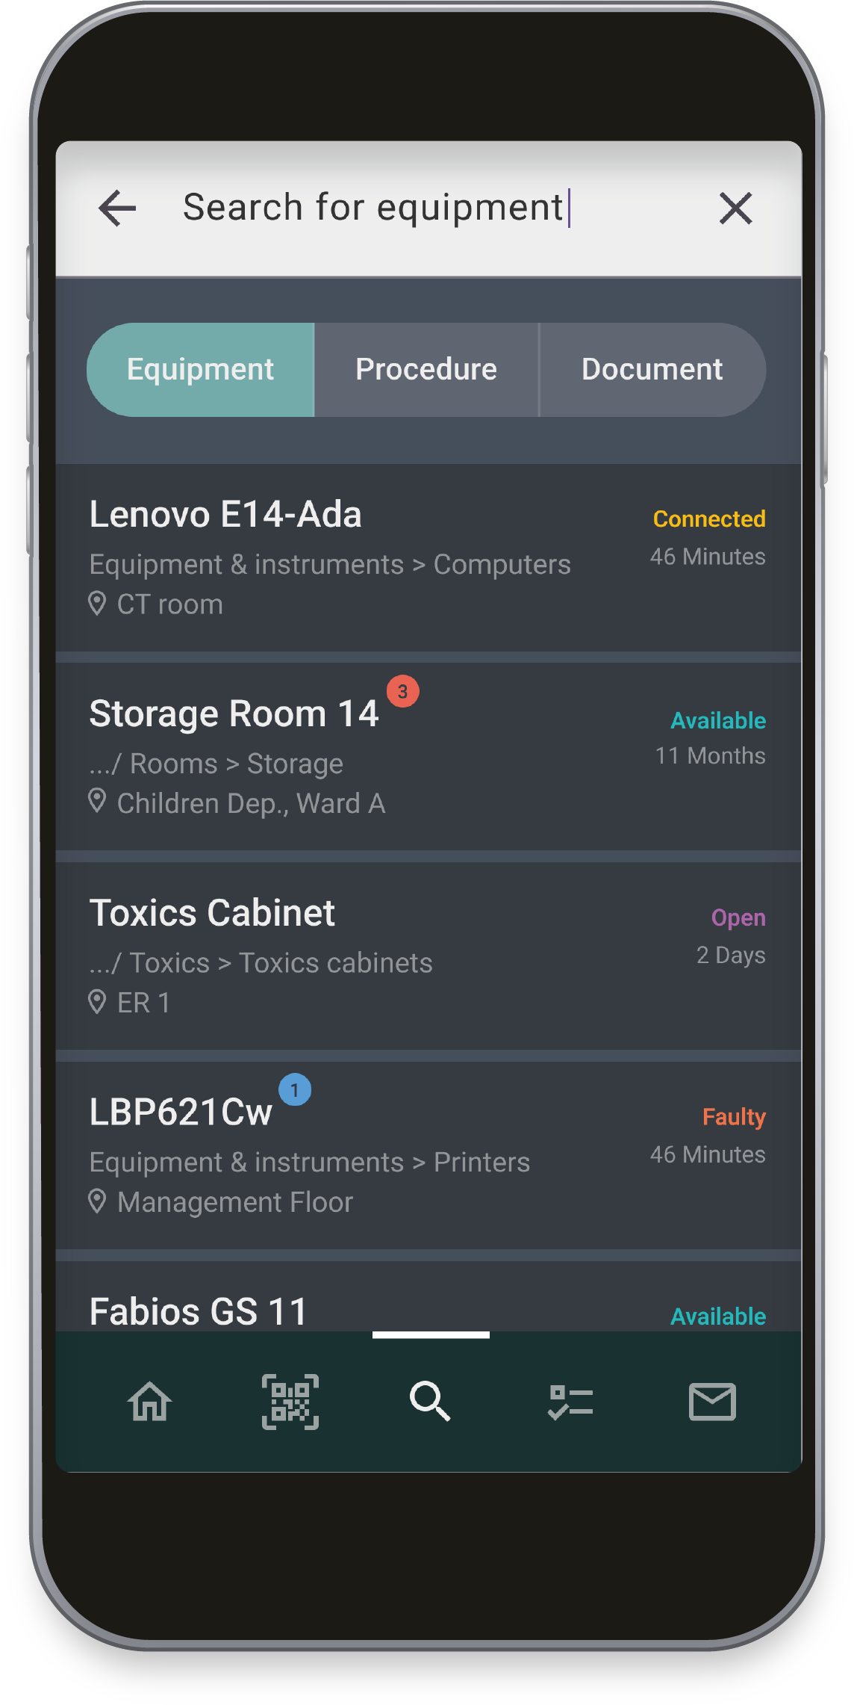
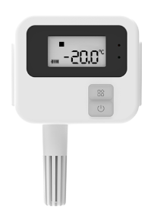
How
It Works
BLE RTLS - topology
Consumers
Personal beacon
Beacon tag
HTTP
MQTP
Gateway
Cloud server
Sensor
Simply Manage.
8

Slide 9
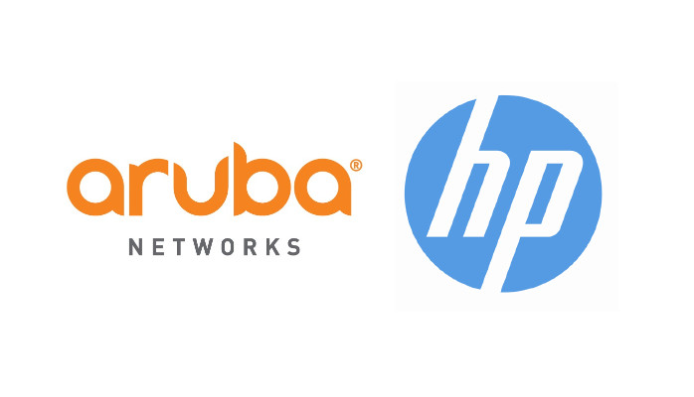
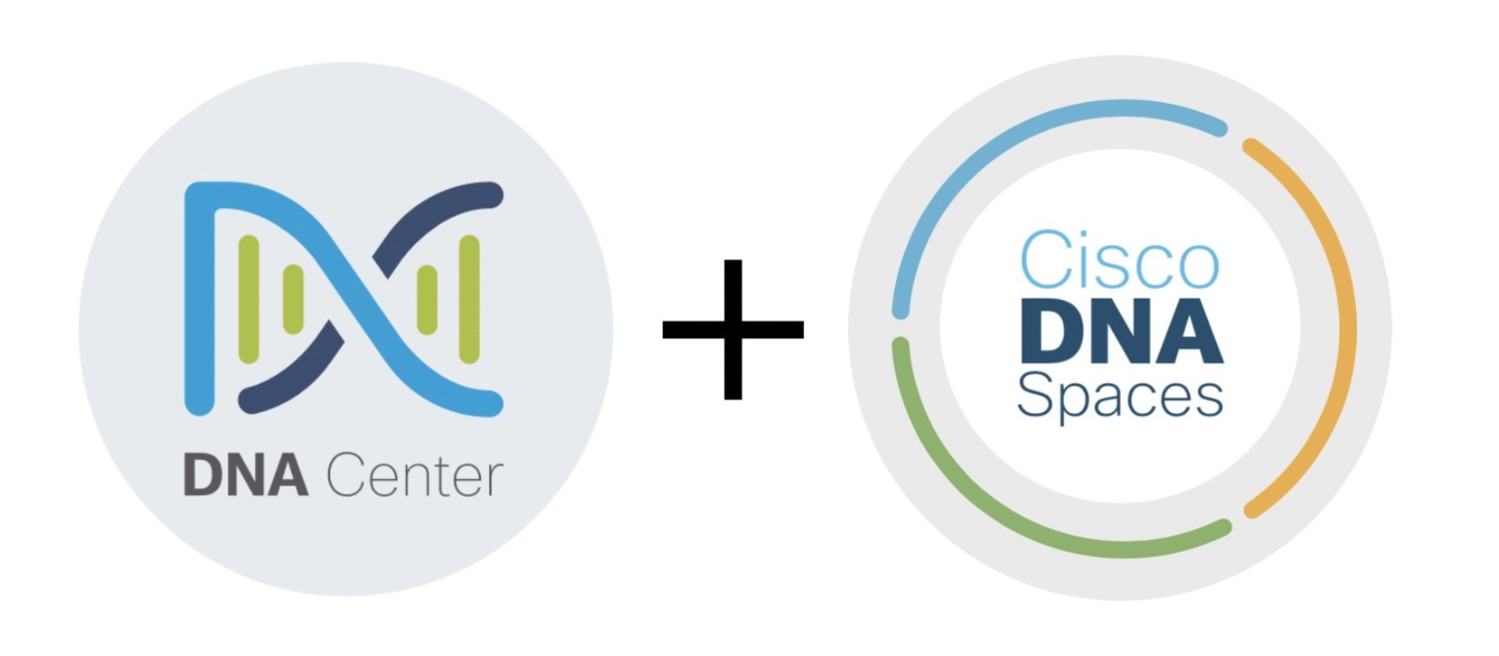
Infrastructure-Based RTLS (Wi-Fi)
Pros:
Enterprise-wide solution that actually works
No dependency on users
Cons:
High cost (many millions)
Long implementation time
Not future proof (Wi-Fi is being replaced by 5G)
Simply Manage.
9

Slide 10



Hardware-Based RTLS
Pros:
No dependency on users
Cons:
High cost
Requires complex setup (network, power)
Only specific, expensive tags
Yet another standalone system
Simply Manage.
10

Slide 11
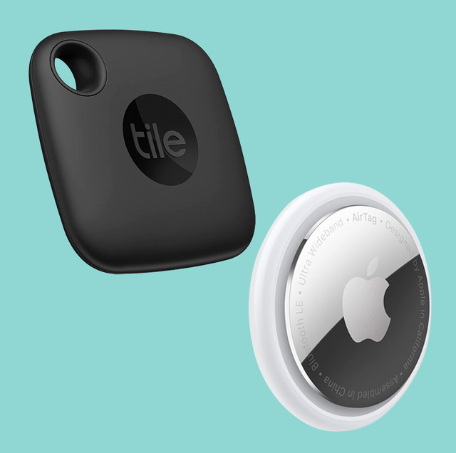
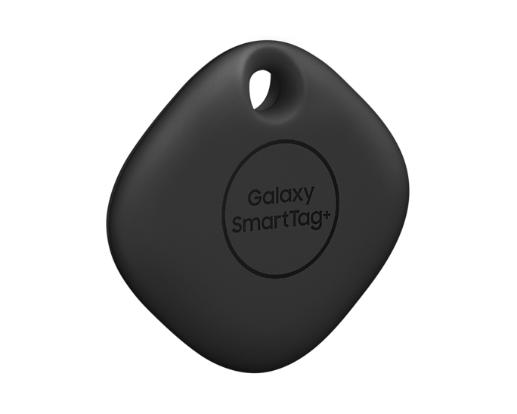
Consumer-Grade mobile based
Pros:
Very low system cost
Super easy setup
Phone based – zero infrastructure
Cons:
Very limited abilities (not for enterprise)
Only specific, expensive tags
GPS location only (useless indoors)
Simply Manage.
11

Slide 12
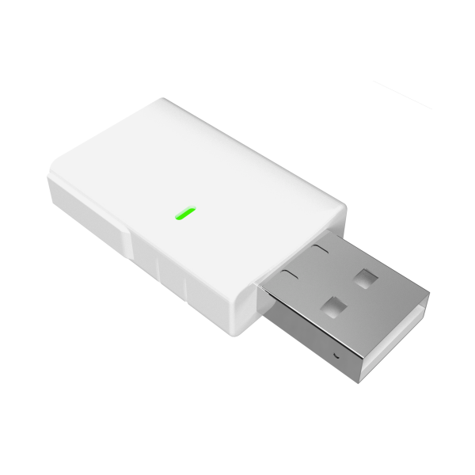

Hybrid RTLS
Pros:
Data is continuously collected by phones
+ Uses your Wi-Fi infrastructure (if exists)
+ Hardware ONLY where and if needed
Future proof:
Any BLE tag AND any equipment with BLE (modern medical equipment)
network can provide <1m accuracy indoors
Simply Manage.
12

Slide 13
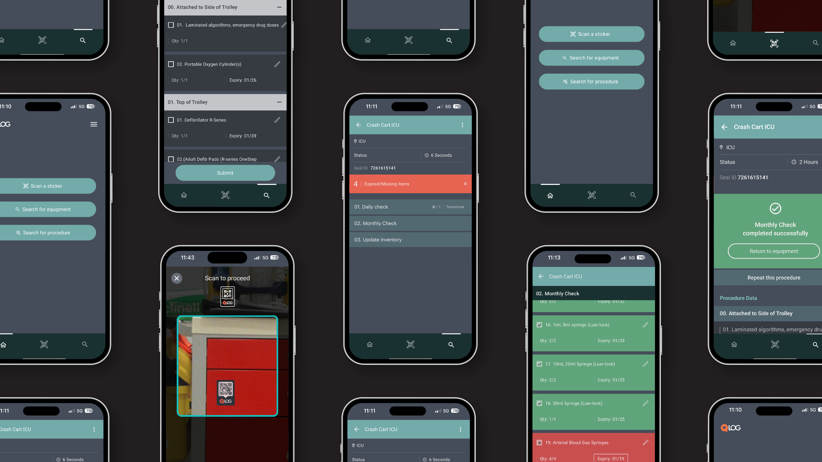

Slide 14

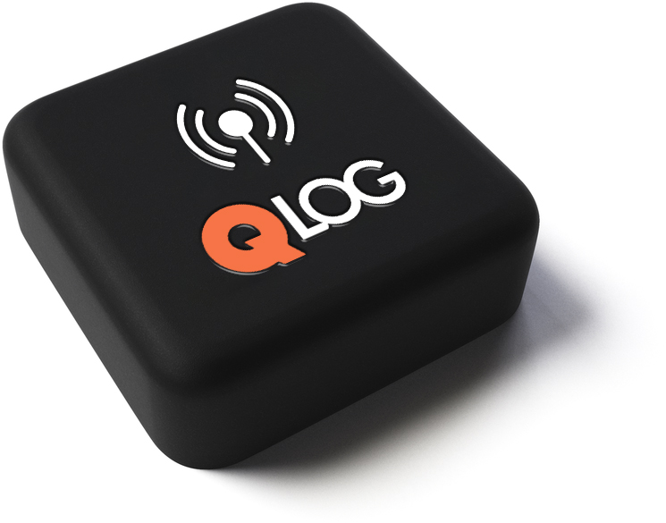
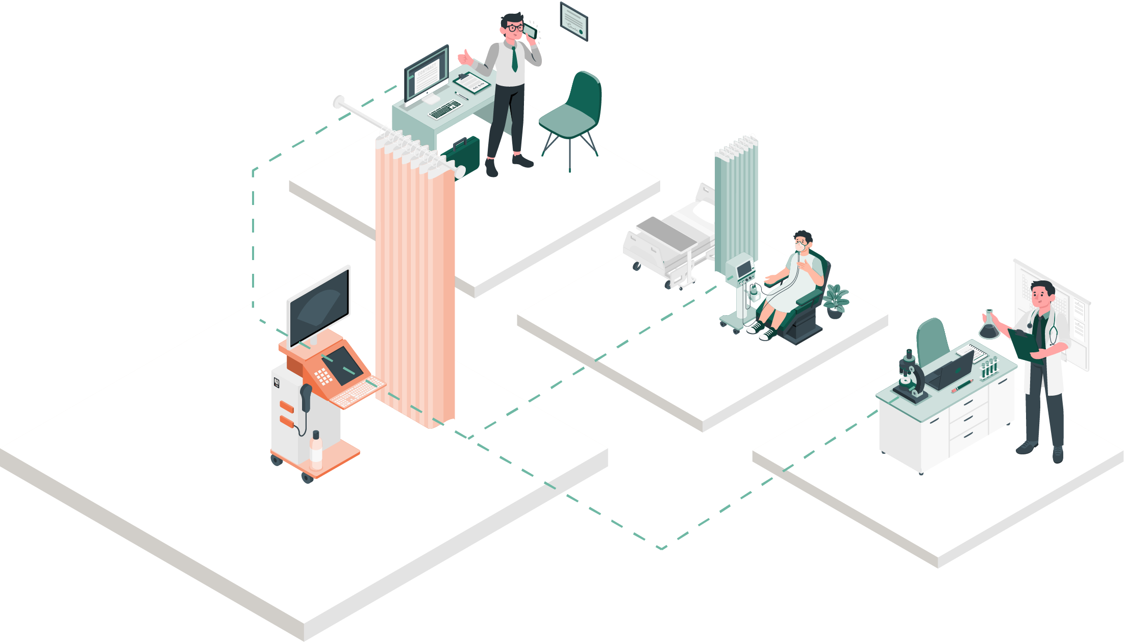

QLOG Hybrid RTLS
Data collected by users as part of the normal activity
Minimal setup – maximal value
Immediate usability
Easy integration
Comp. Screen
Room 307 (CEO)
Building A
In use
Ventilator
Room 203 (ICU)
Building A
Connected
Microscope
Room 136 (lab)
Building B
Available
Simply Manage.
14

Slide 15
Considerations
What are my needs
What is the size of my facility?
How many items do I need tracked?
What is the needed accuracy?
How urgent is the need?
Which technology is right for me?
What infrastructure already exists?
What are the long-term infrastructure plans?
What are my team's abilities?
What solution to buy
What does the solution include?
How well does it integrate with my systems?
Who will use it, and what are their needs?
Who to buy from
Current vs. New provider
Local vs. Global provider
Contract type – subscription vs. CAPEX
Simply Manage.
15

Slide 16

Thank You
Amit Lehavi ,MD Founder & CEO
amit@qlog.co / +972.50.2061419
For more information, please contact us
www.qlog.co

